Slide 1
Dredged Material Management Area BV-11 Construction

Slide 2
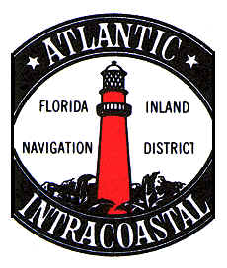


Project Team

Slide 3
Need for Project
  The permanent DMMA will serve Reach III of the Intracoastal Waterway (ICW) in Brevard County during channel maintenance operations.
  The DMMA will provide sufficient capacity to dewater and store 514,000 CY of dredged material

Slide 4
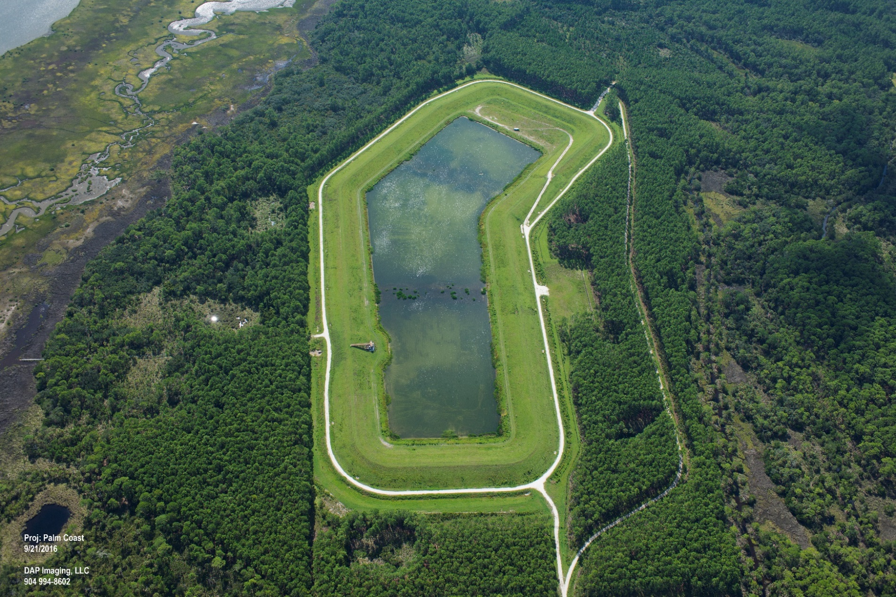
What is a DMMA and How Does it Work?
Aerial View DMMA Site FL-3

Slide 5
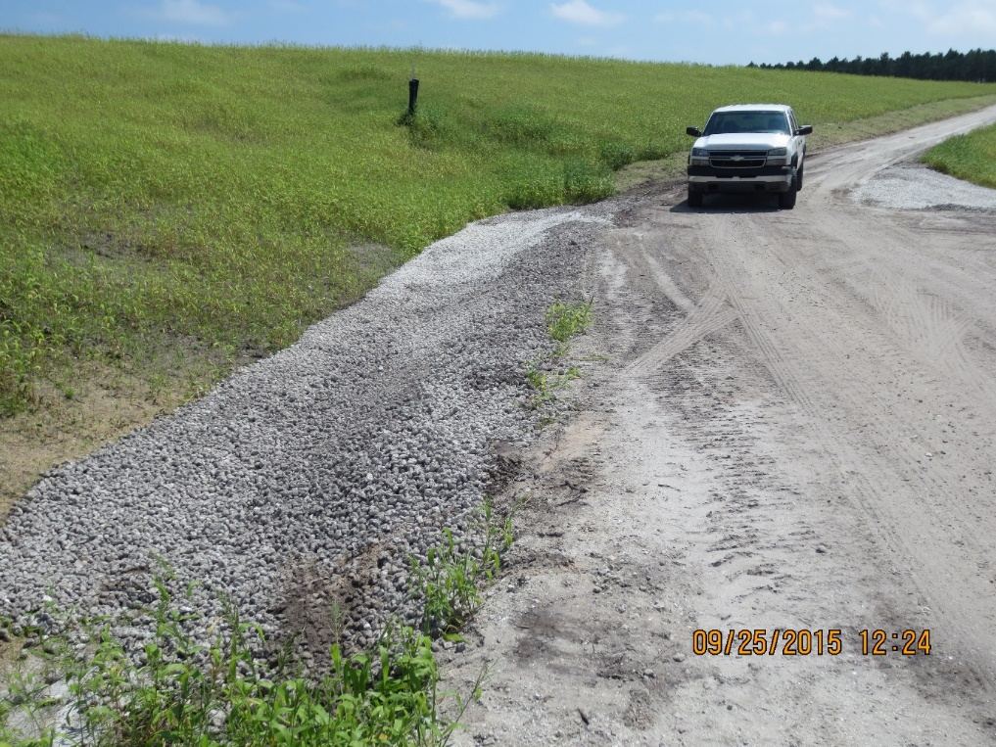
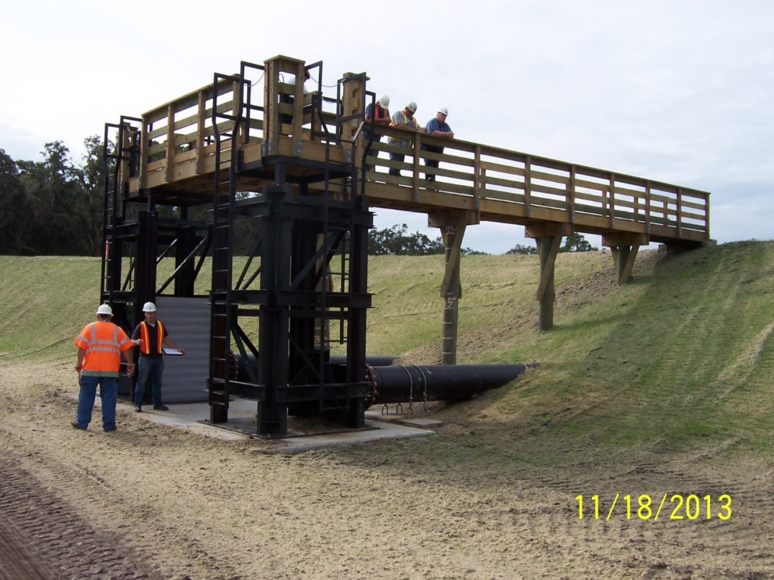
What is a DMMA and How Does it Work?
Exterior View
Interior View

Slide 6
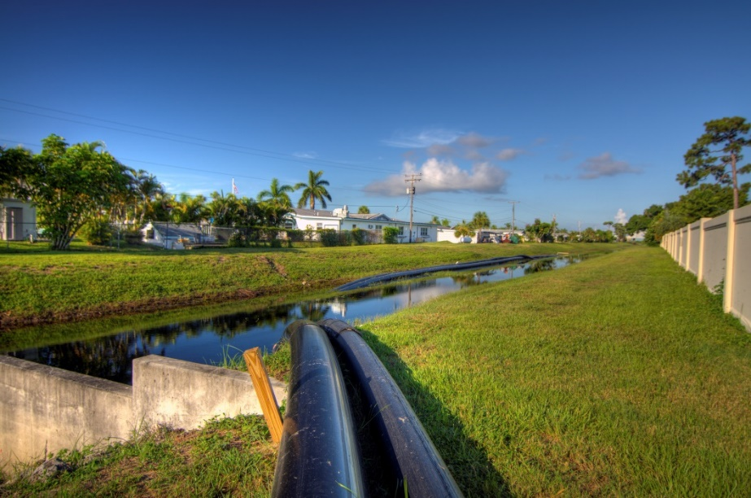
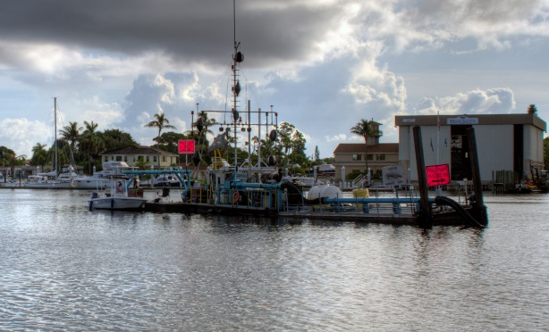
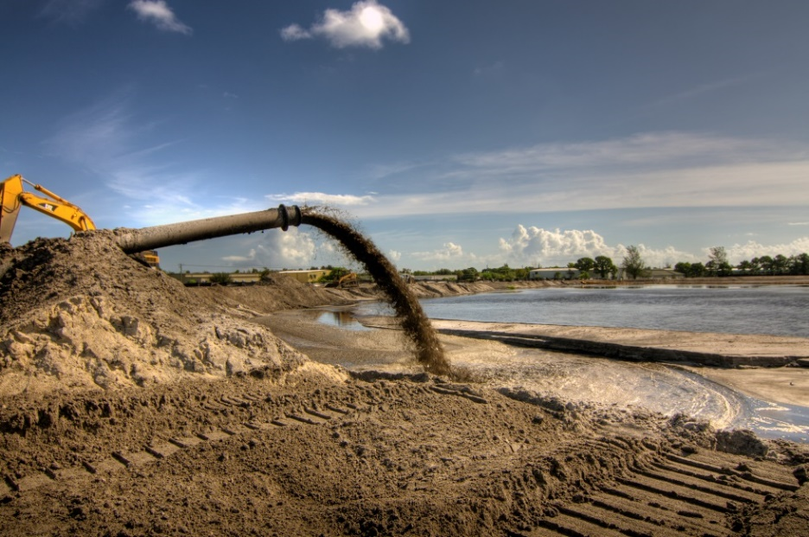
What is a DMMA and How Does it Work?
Typical Paired Pipeline
Typical DMMA View
Hydraulic Dredge

Slide 7
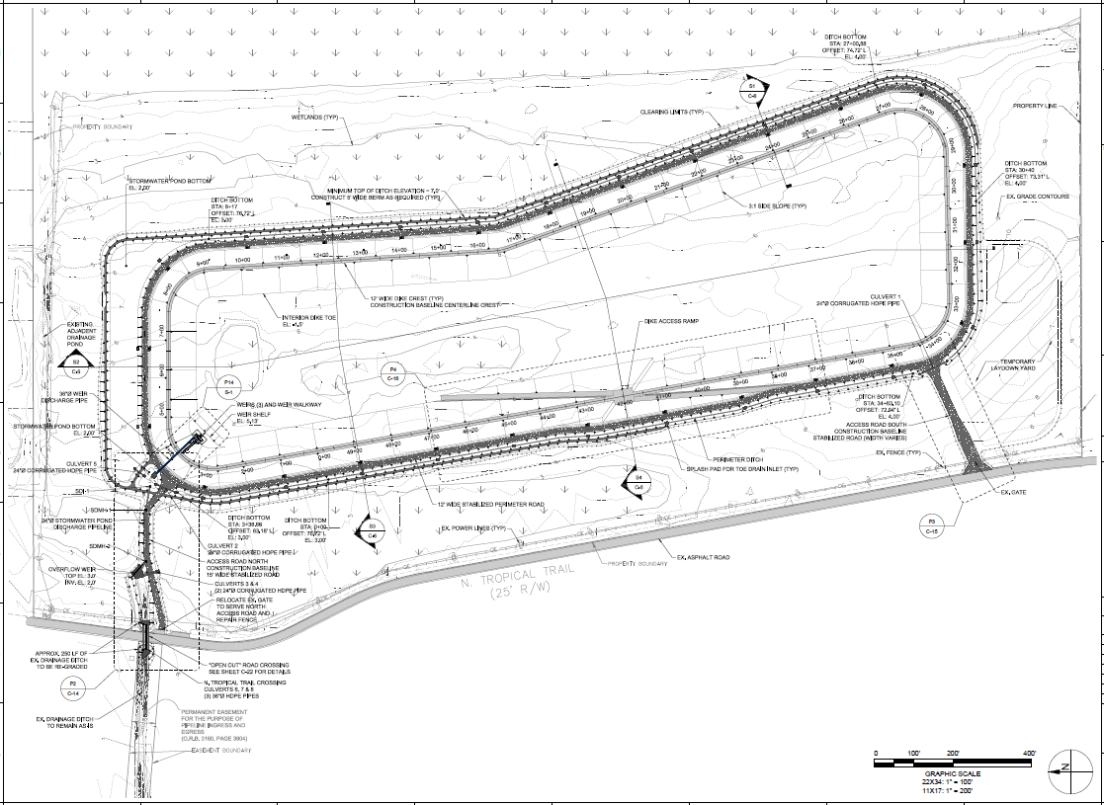
DMMA BV-11 Plan View

Slide 8
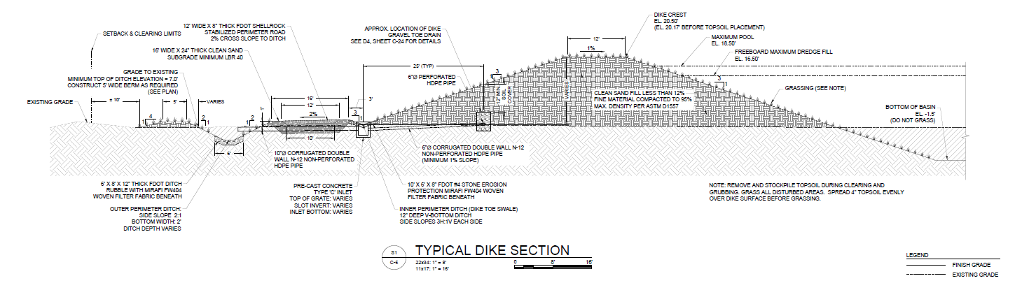
DMMA BV-11 Section View

Slide 9
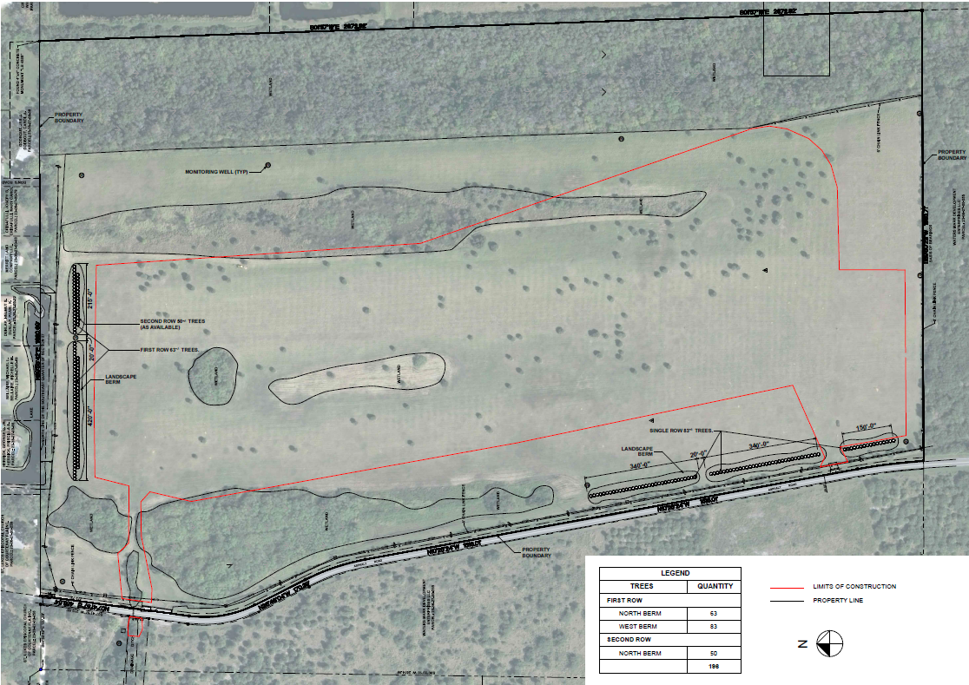
Tree Relocation and Landscaping Berm

Slide 10
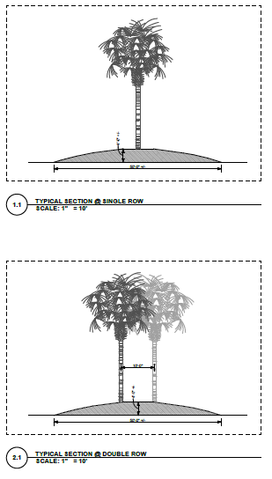
Tree Relocation and Landscaping Berm

Slide 11
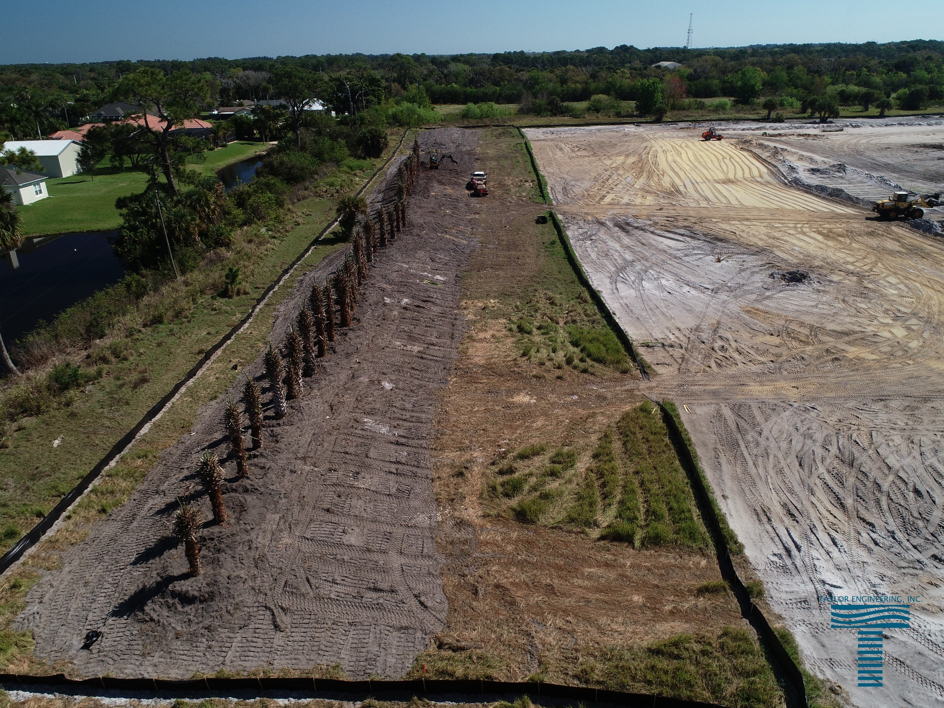
Tree Relocation and Landscaping Berm

Slide 12
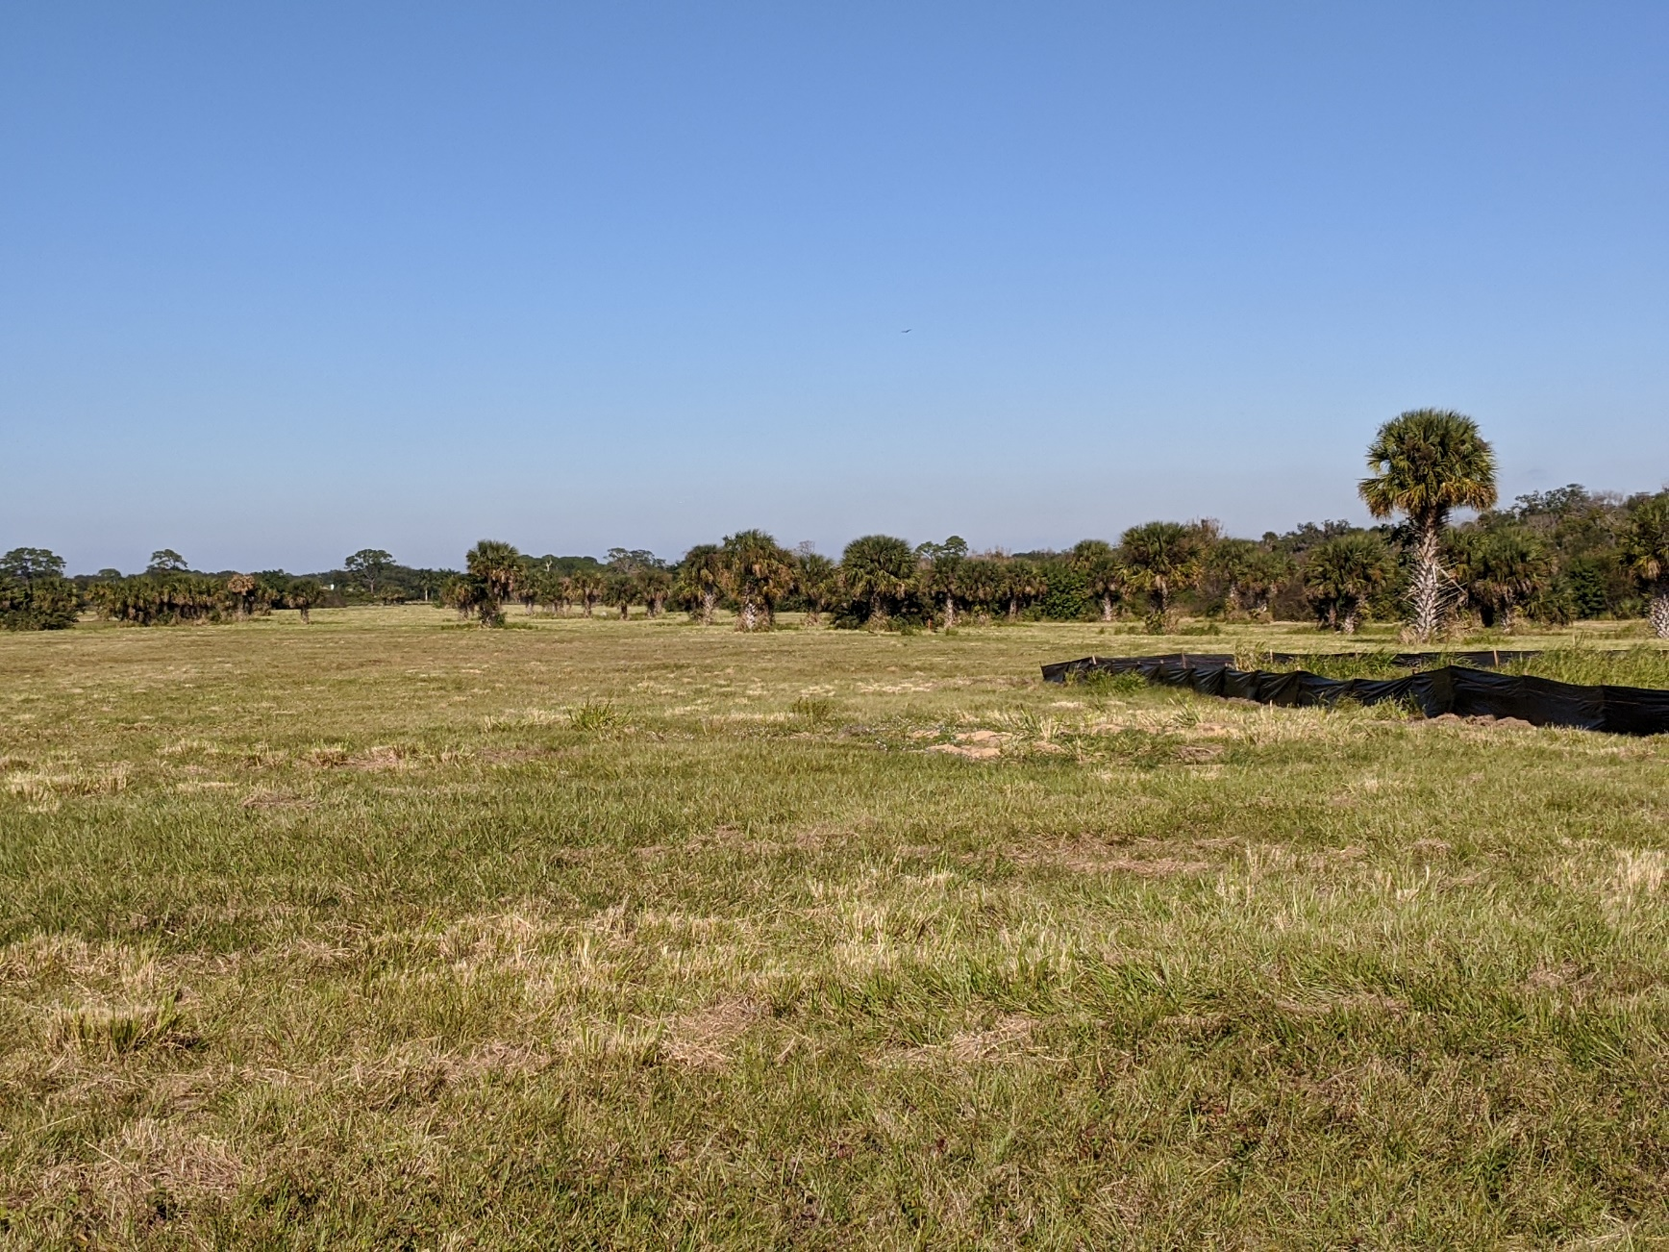
Construction Progress - December

Slide 13
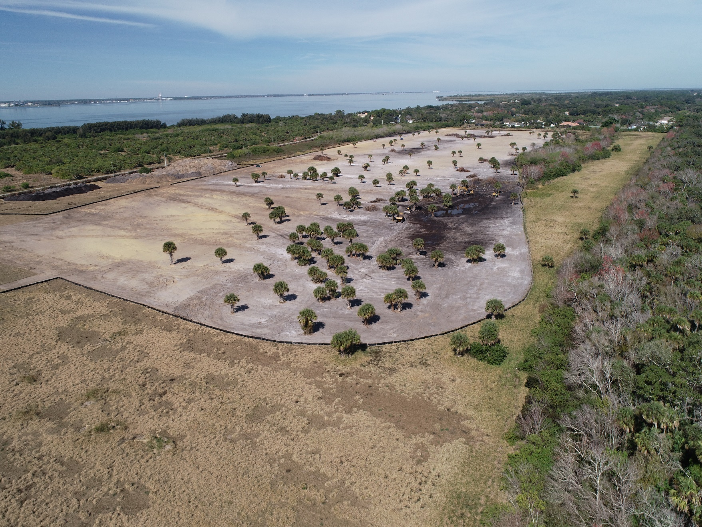
Construction Progress - January

Slide 14
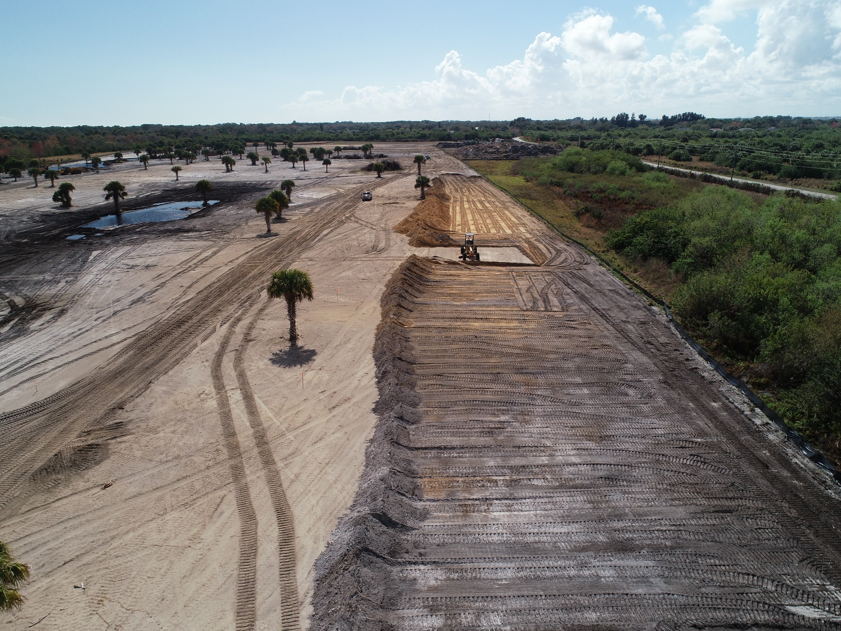
Construction Progress - February

Slide 15
Construction Progress - February

Slide 16
DMMA BV-11 Construction
Questions?

